Slide 1
Sign language recognition
sUbmitted by : b. Balakrishna
reg no:22a21f0008
mentor : a. n. l. kumar sir

Slide 2
introduction
Communication is very crucial to human beings, as it enables us to express ourselves. We communicate through speech, gestures, body language, reading, writing etc. Unfortunately, for the speaking and hearing impaired minority, there is a communication gap. Visual aids, or an interpreter, are used for communicating with them. However, these methods can't be used in an emergency.
Sign Language uses manual communication to convey meaning. This involves simultaneously combining hand shapes, orientations and movement of the hands to express the speaker's thoughts. Sign Language consists of finger spelling, which spells out words character by character to convey the word meaning. Finger spelling is not widely used as it is challenging to understand and difficult to use and very few people know it, which makes it an insufficient alternative for communication.
A system for sign language recognition that classifies finger spelling can solve this problem. Various machine learning algorithms are used and their accuracies are recorded and compared .

Slide 3
Problem statement
Sign language is a visual language used by people with hearing impairments to communicate with each other. The goal of sign language recognition is to develop a system that can accurately recognize and translate sign language in real-time, allowing for effective communication between deaf and hearing individuals. The problem is to develop a robust and accurate sign language recognition system that can recognize a wide range of signs and gestures.

Slide 4
methodology
Communication is very crucial to human beings, as it enables us to express ourselves. We communicate through speech, gestures, body language, reading, writing etc. Unfortunately, for the speaking and hearing impaired minority, there is a communication gap. Visual aids, or an interpreter, are used for communicating with them.
Gather a diverse dataset of sign language gestures and expressions. This dataset should include various signs, hand movements, and possibly facial expressions associated with different meanings.
Clean and preprocess the collected data to ensure consistency and remove any noise or irrelevant information. This step may involve image or video processing techniques to enhance the quality of the data.

Slide 5
methodology
Identify and extract relevant features from the preprocessed data. In the context of sign language recognition, features may include hand shapes, movements, and other distinctive characteristics of each sign.
Utilize machine learning algorithms to train a model on the preprocessed and feature-extracted data. Common approaches include neural networks, support vector machines, or other pattern recognition techniques.
Validate the trained model using a separate dataset not used during training. This step ensures that the model generalizes well to new, unseen data. Testing involves assessing the model's accuracy and performance.

Slide 6
methodology
Webcam integration in sign language recognition involves positioning a webcam to capture and interpret users' signing gestures. Real-time video from the webcam is processed using computer vision algorithms to detect and recognize sign language gestures. The integrated model classifies these gestures, providing instant feedback through a user-friendly interface. Continuous learning mechanisms adapt the system to different signing styles. Privacy considerations and thorough testing precede the deployment of this technology for enhanced communication and inclusivity.

Slide 7
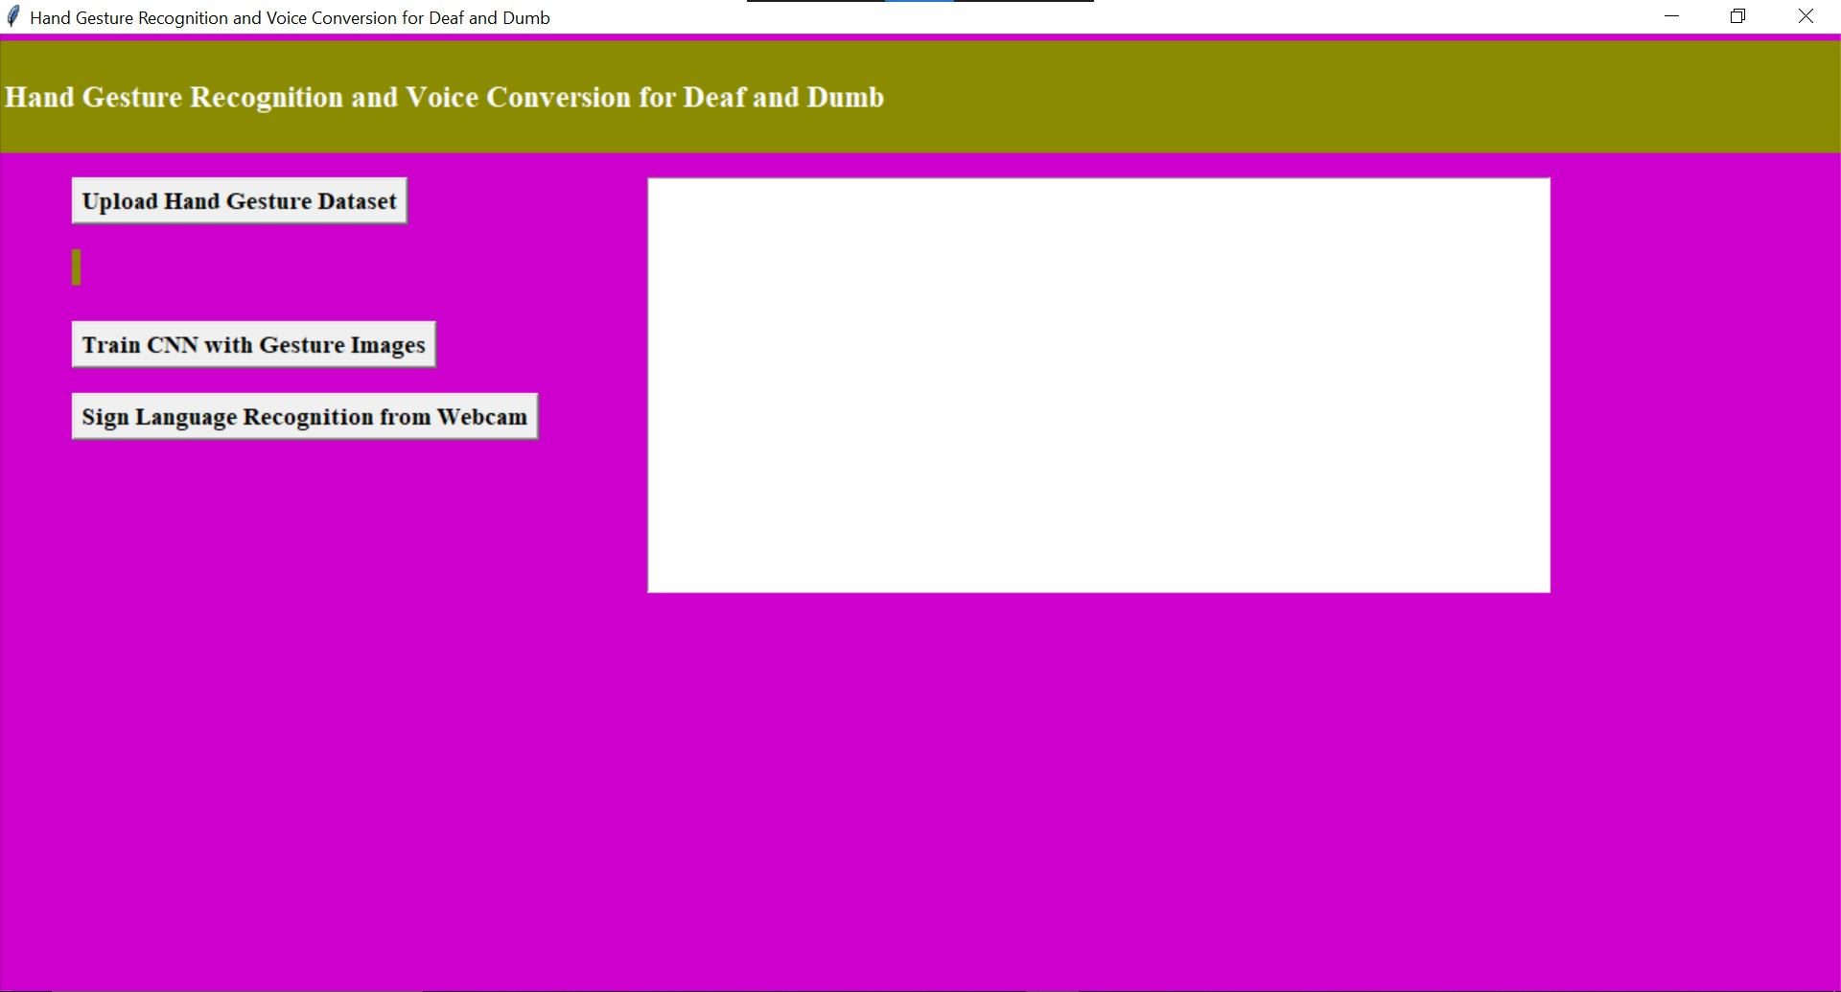
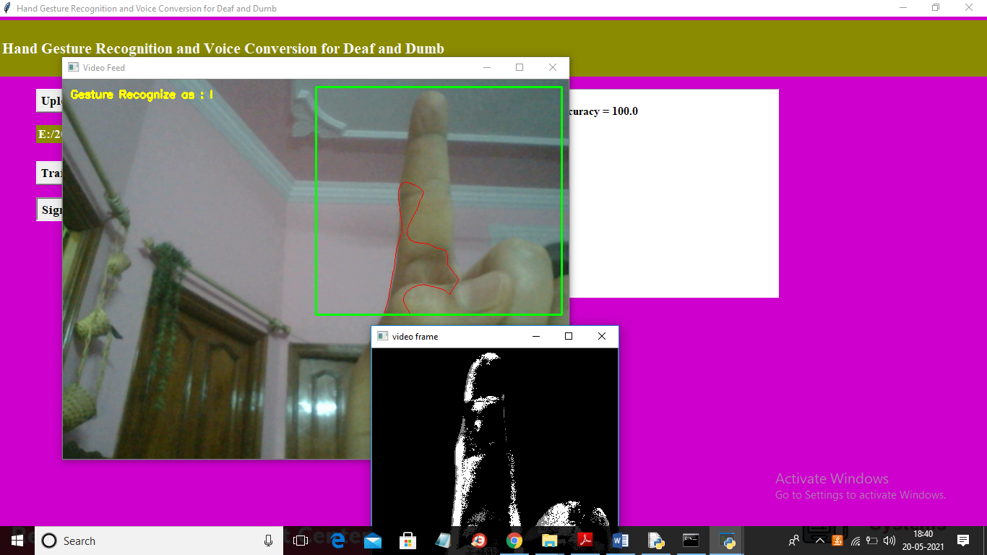
Results

Slide 8
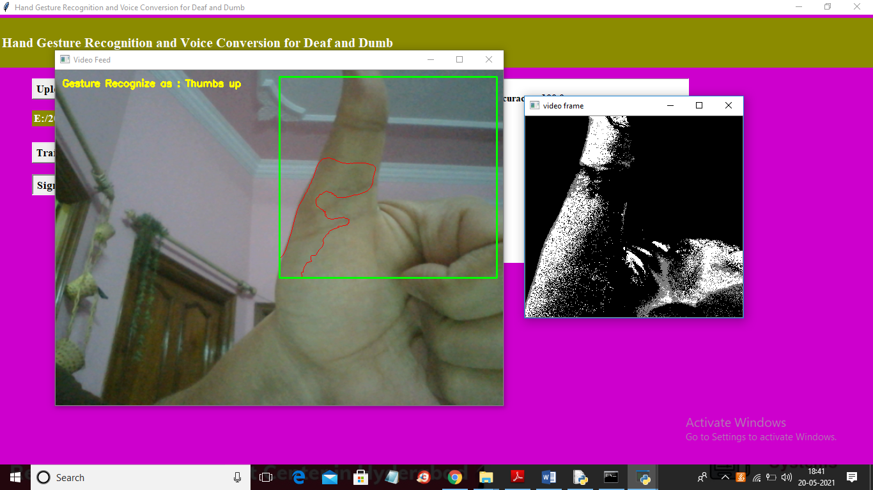
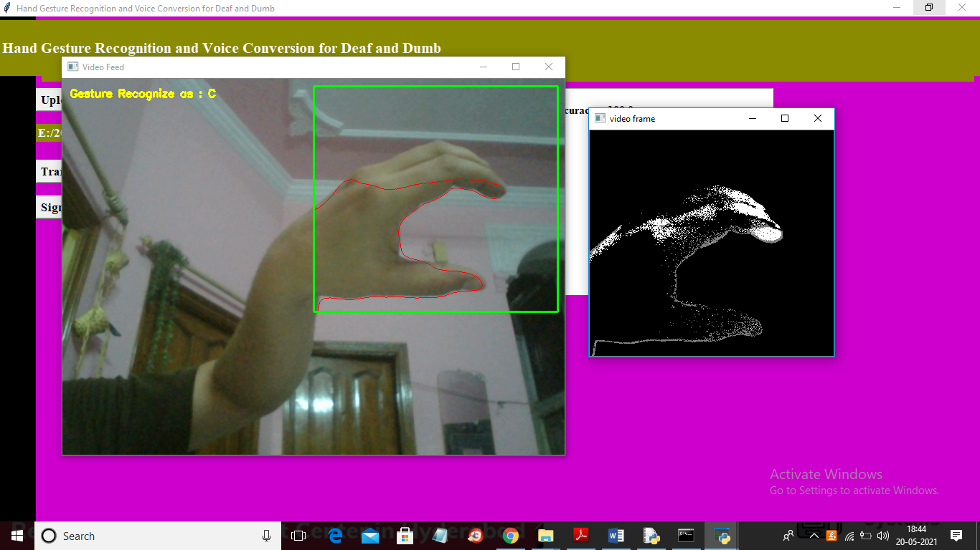
Results

Slide 9
discussion
Sign language recognition involves the use of technology to interpret and understand gestures and movements used in sign languages. It plays a crucial role in facilitating communication for the deaf and hard of hearing. Various approaches, including computer vision and machine learning, are employed to develop accurate sign language recognition systems. Challenges include the complexity of sign language grammar and the need for robust real-time recognition. Advances in this field hold great potential for improving accessibility and inclusion.

Slide 10
conclusion
The use of the CNN algorithm for hand gesture recognition and voice conversion has the potential to greatly improve communication and accessibility for the deaf and dumb community. Further research and development in this area can lead to more advanced and accurate models, which can benefit a wider range of users.

Slide 11


